Slide 1
Adidas Sales Analysis: Retail Performance and Product Insights
kaushikmaji44@gmail.com / Kaushik Maji

Slide 2
About the dataset
Data Insights
Relevant inquiries

Slide 3
About the dataset

Slide 4
About the dataset
The Adidas Sales Analysis includes over 9,000 entries detailing sales across retailers like Amazon and Foot Locker. Key insights reveal West Gear in Houston excels in Outlet sales with an average price of $45 and total sales of $93,273. Foot Locker in New York emphasizes in-store sales, highlighting strategic product placement's impact on revenue.

Slide 5
Data Insights

Slide 6
Sales and Operating Profit Correlation Analysis Over Time
Strong Correlation: Pearson correlation coefficient of 0.998 indicates a robust relationship between total sales and operating profit.
Trends Visualization: Sales and profit metrics from 2020 to 2021 show similar patterns, emphasizing the impact of sales fluctuations on profitability.
Sales Growth Importance: Strategies to increase sales are crucial for enhancing overall financial performance.

Slide 7
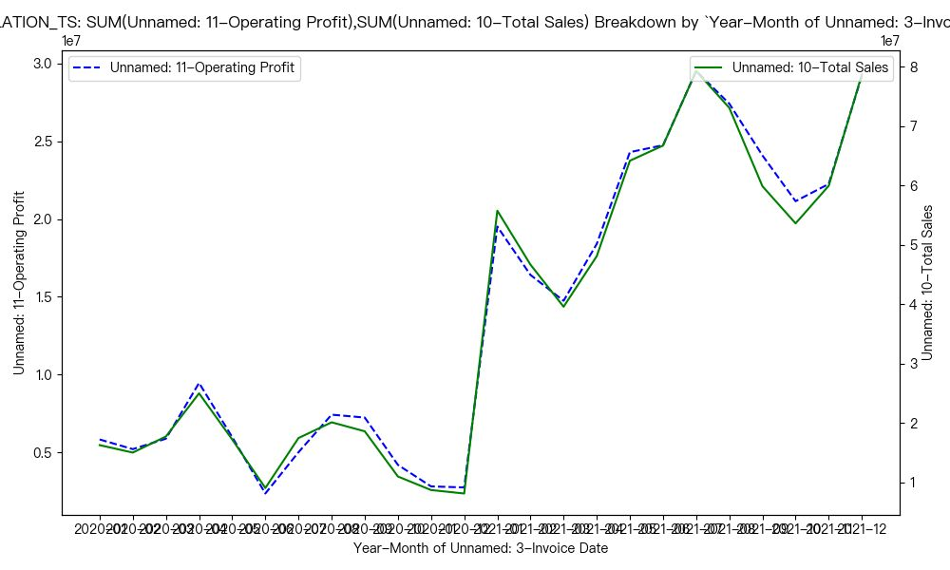

Slide 8
Sales and Units Sold Correlation Analysis by Invoice Date
Strong Correlation: Pearson correlation coefficient of 0.99 between total sales and units sold.
Sales Trends: Distinct peaks and troughs indicate fluctuations, with higher sales volumes leading to increased revenue.
Strategic Insight: Understanding these patterns aids in inventory management and sales forecasting for better planning.

Slide 9
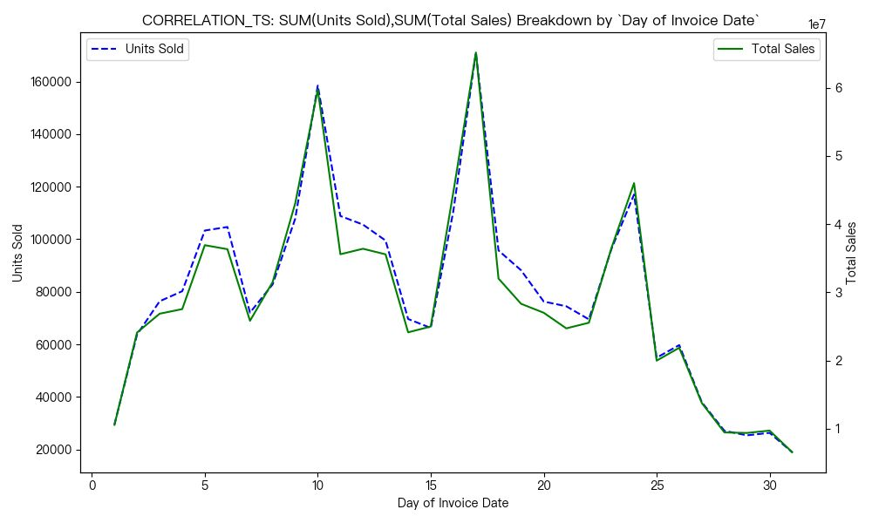

Slide 10
Sales and Units Sold Correlation by State
Strong Positive Correlation: Pearson correlation coefficient of 0.96 between total sales and units sold.
Linear Relationship: Most states show a consistent trend where higher sales volumes correlate with higher unit sales.
Outliers: A few states deviate from the trend, suggesting the need for further investigation for strategic planning.

Slide 11
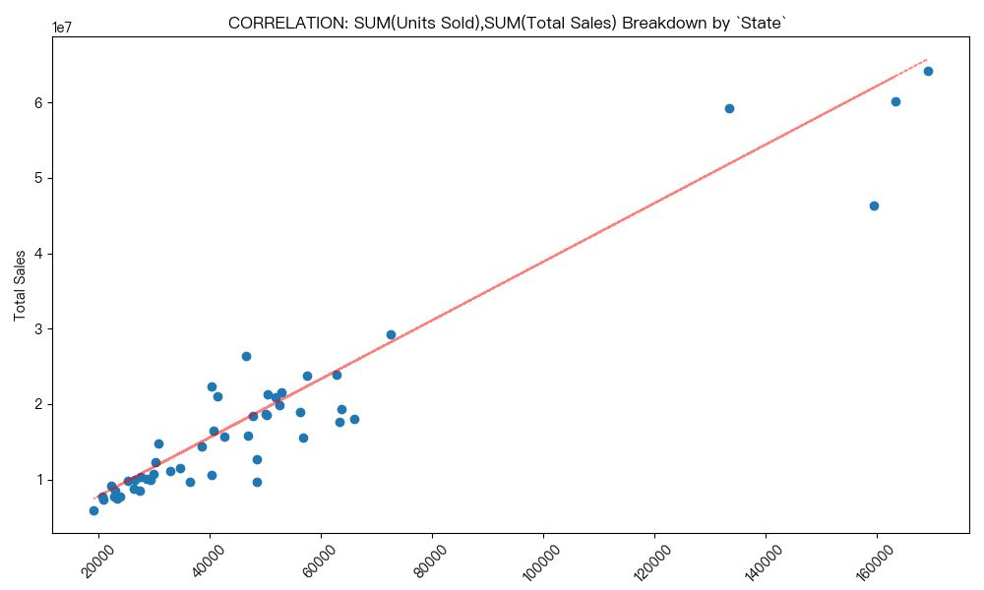

Slide 12
Sales and Pricing Correlation by State
Strong Positive Correlation: Pearson correlation coefficient of 0.91 between total sales and price per unit.
Scatter Plot Visualization: Data points cluster around a linear trend line, indicating higher prices lead to higher sales.
Strategic Insight: Understanding this relationship aids in pricing strategies and sales forecasting across states.

Slide 13
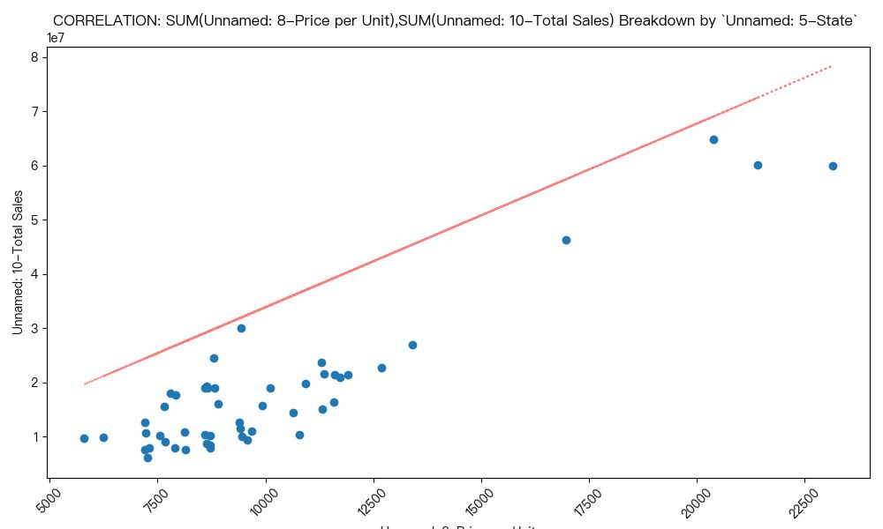

Slide 14
Operating Margin and Sales Analysis
Scatter Plot Analysis: Illustrates the relationship between mean operating margin and total units sold.
Data Clustering: Most points show lower margins, with an outlier at 0.7 indicating high-value sales.
Strategic Insight: Higher sales volumes may lead to lower margins, emphasizing the need to balance sales volume with profitability for optimal performance.

Slide 15
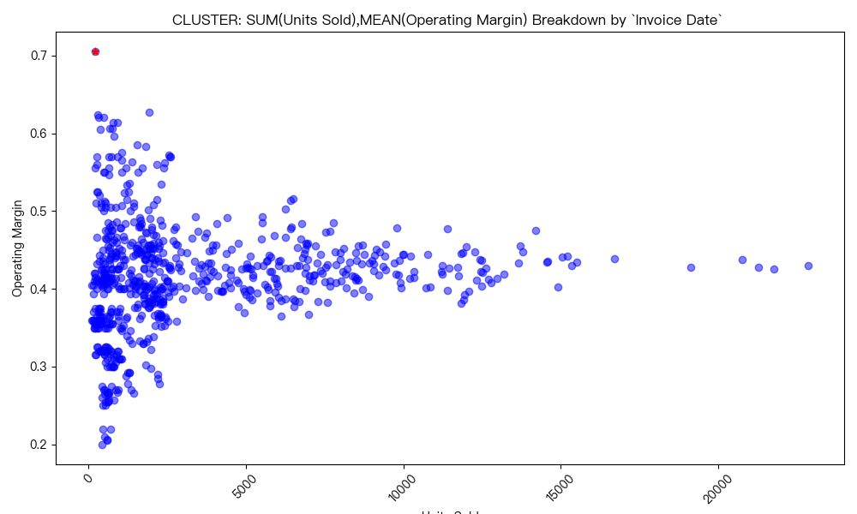

Slide 16
Relevant inquiries

Slide 17
Trends in Retail Sales Over Time
Retailers Analyzed: Includes West Gear, Foot Locker, Sports Direct, Kohl's, Amazon, and Walmart.
Sales Statistics: Average sales of 658,304.41 with a range from 8,974 to 5,908,344.
Conclusion: Significant sales variability and retailer-specific trends indicate external factors or strategies influence performance.

Slide 18
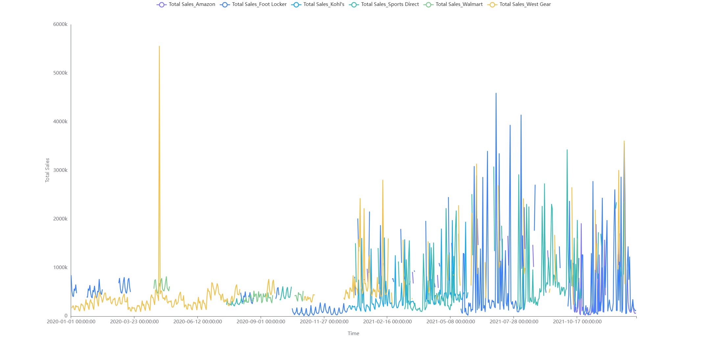

Slide 19
Operating Margin by Product Category
Online Sales Dominance: Online sales yield the highest operating margins across all categories, with margins ranging from 0.44 to 0.49.
In-Store Sales Lag: In-store sales consistently show the lowest margins, between 0.33 and 0.38.
Strategic Recommendation: Focus on enhancing online sales strategies to maximize profitability.

Slide 20
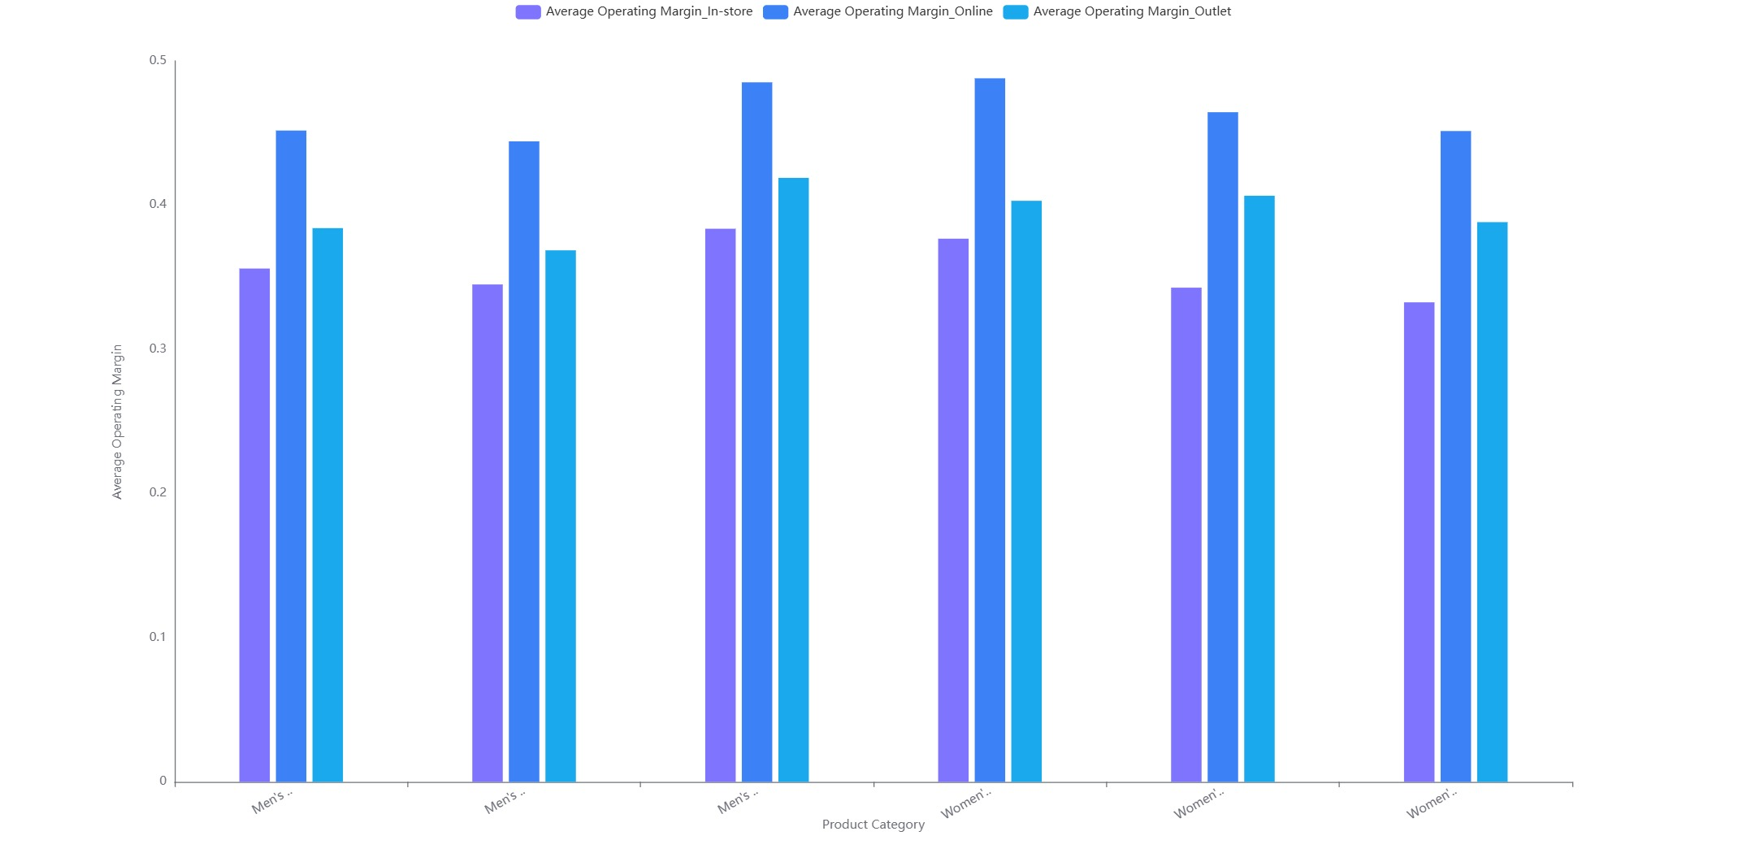

Slide 21
Sales Methods and Profit Analysis
In-store Sales Dominance: The Southeast leads with 615.77 units sold and 131,868.88 in operating profit.
Online Sales Challenges: Lower averages, with the Northeast at 2,400.46 in profit.
Regional Insights: Midwest excels in outlet sales (305.88 units, 53,821.23 profit), highlighting regional preferences.

Slide 22
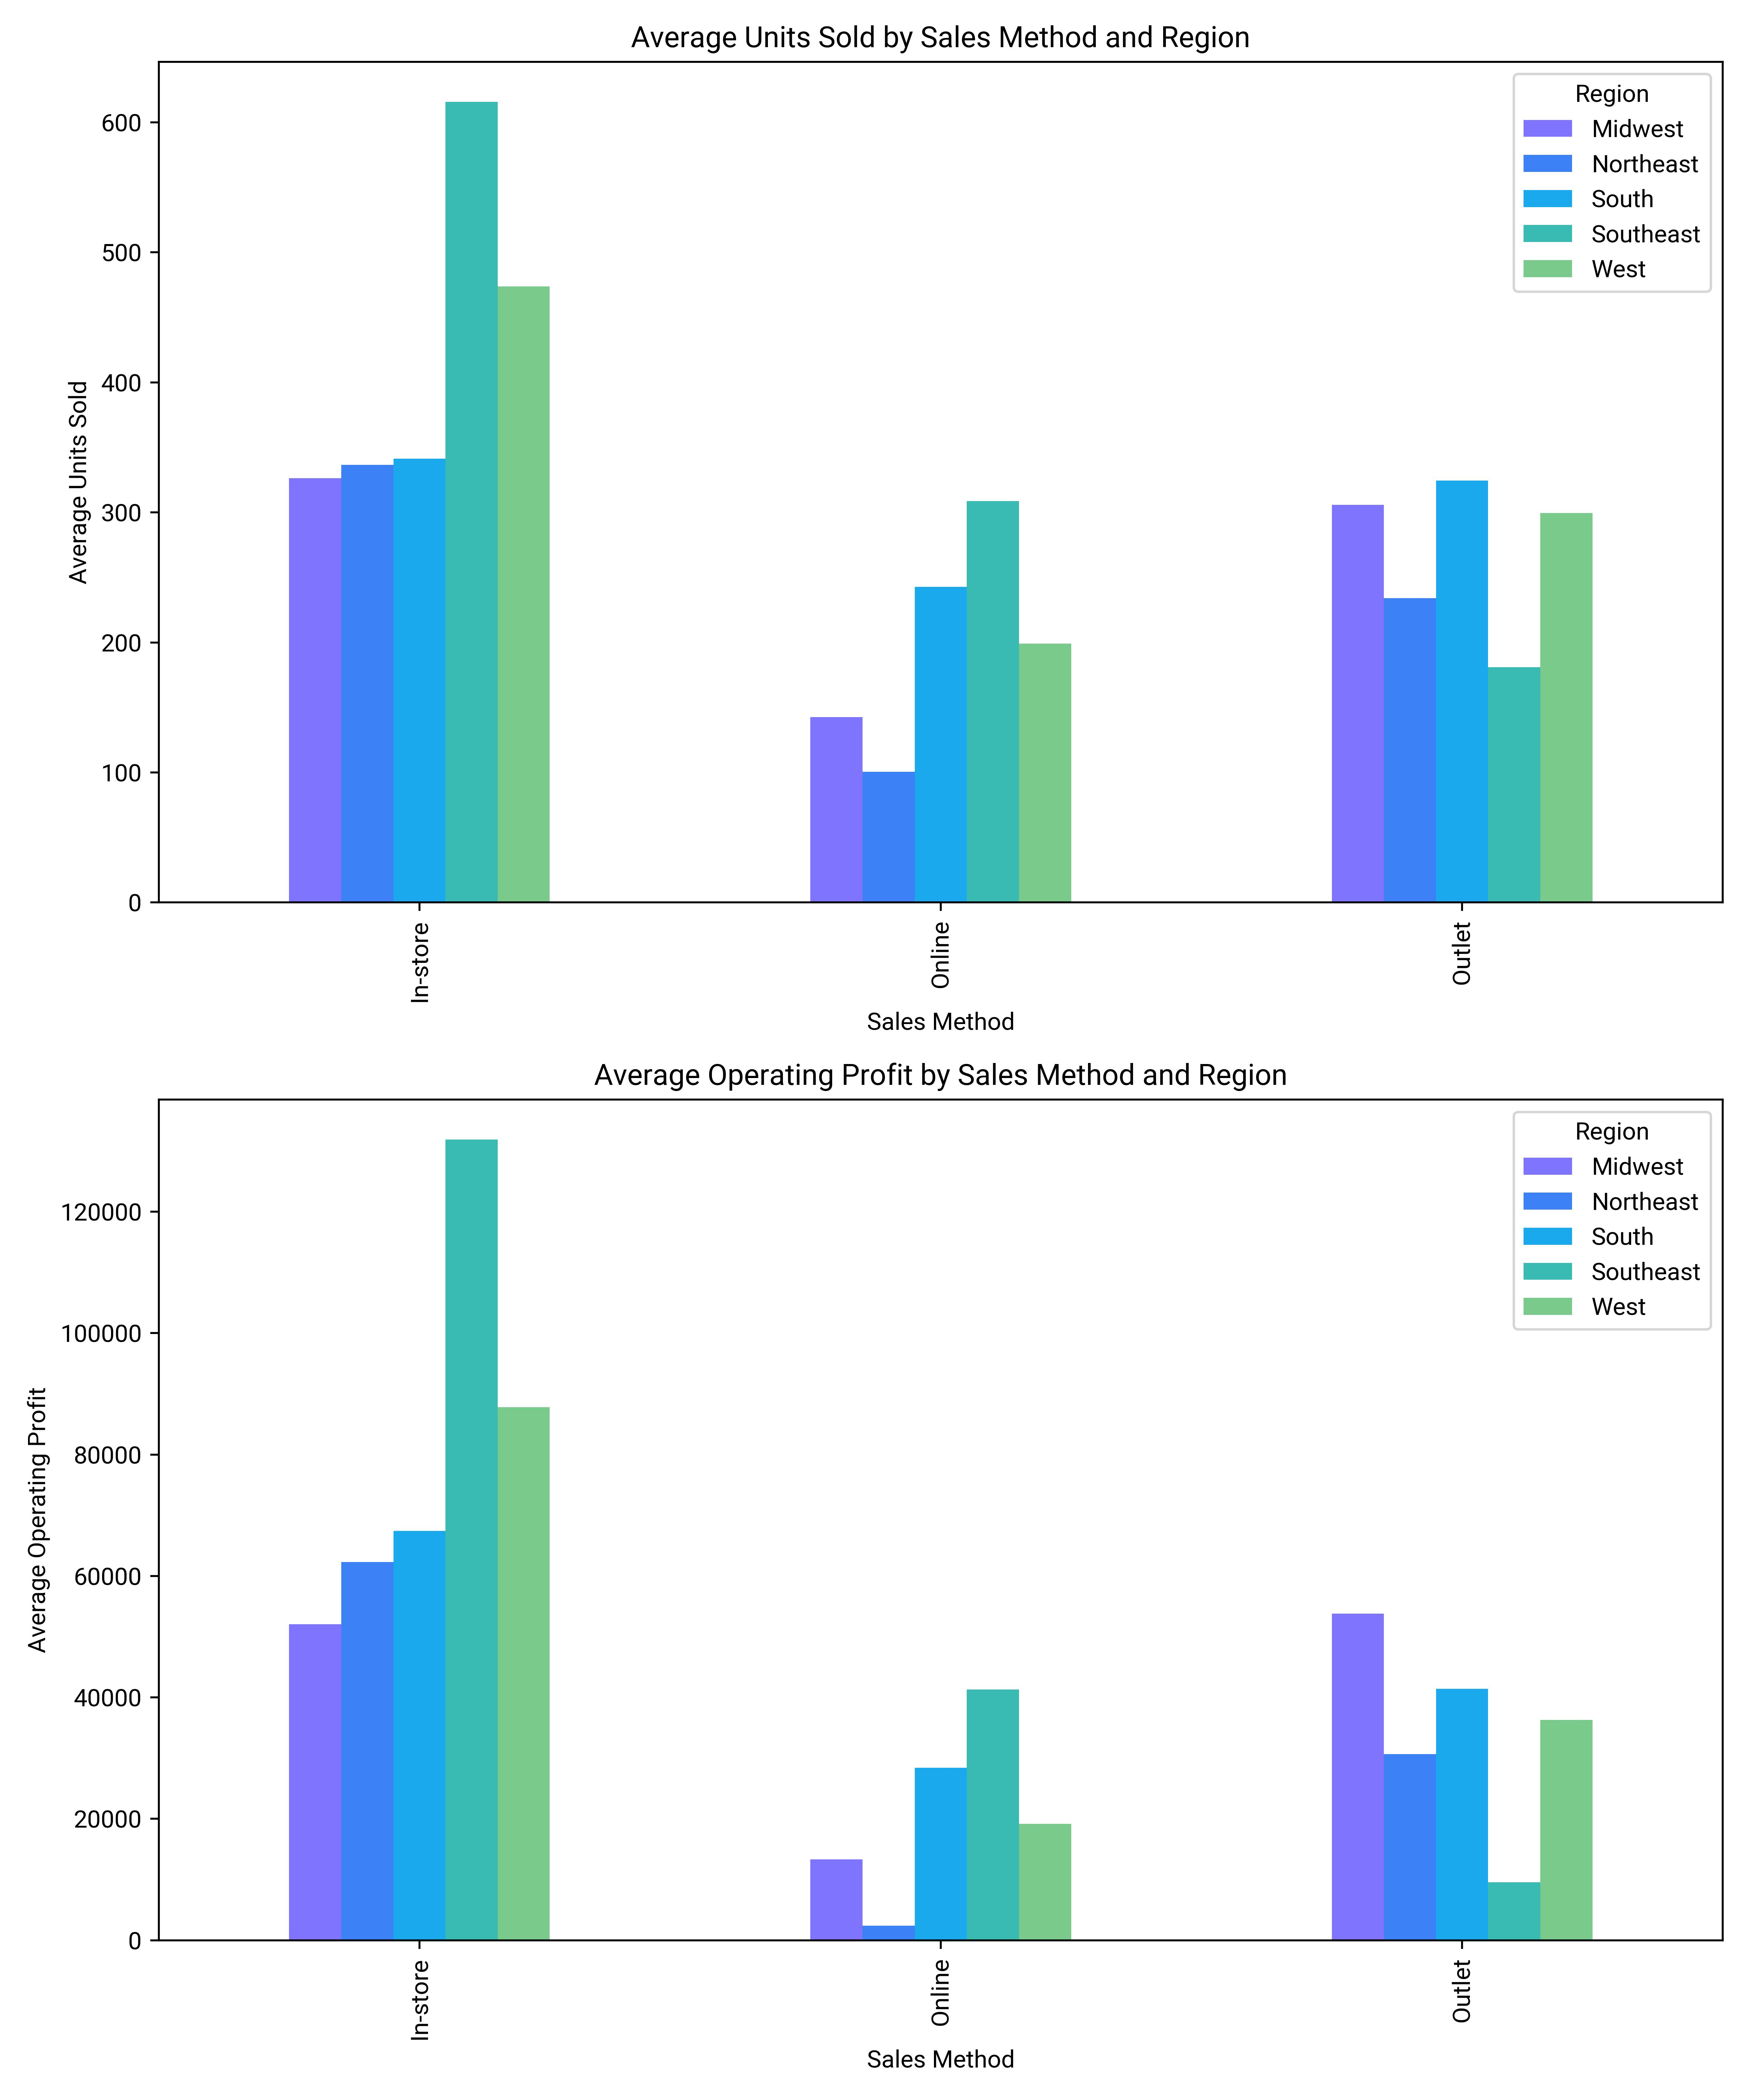

Slide 23
Price Patterns Across States
Mean Price: Average price per unit is 45.30 with a range of 26.83 to 67.65.
State Variability: States like Alaska and Arkansas show higher price variability.
Conclusion: Regional pricing strategies lead to significant differences in unit prices across states and cities.

Slide 24
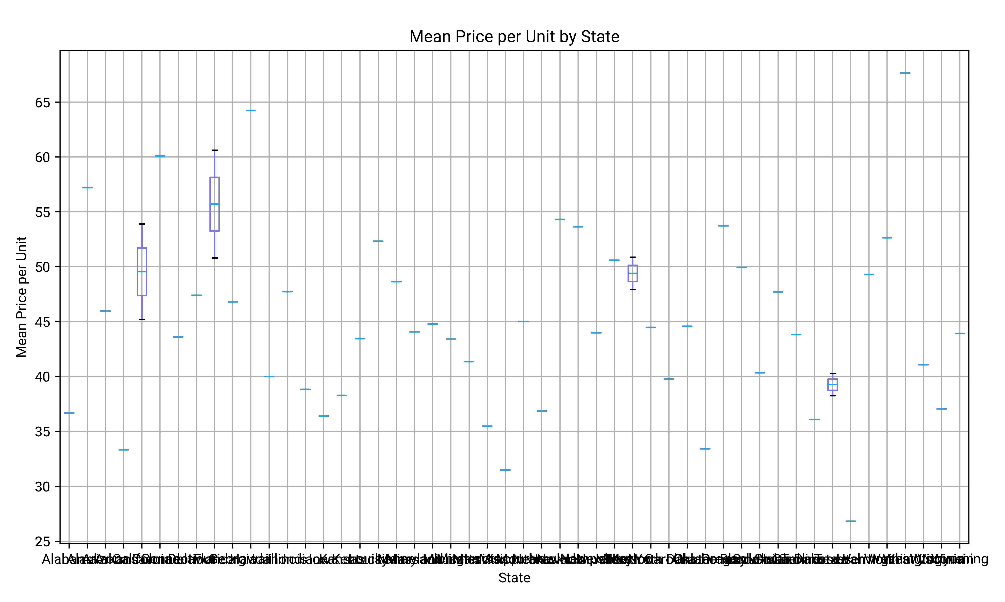

Slide 25
Sales Methods and Total Impact
Sales Method Preference: Online methods dominate across retailers, with Amazon (540) and Foot Locker (1395) leading.
Sales Impact: Foot Locker ($76.5M) and West Gear ($156.7M) excel in in-store sales, highlighting its effectiveness for certain products.
Total Sales Variation: Total sales vary significantly despite the preference for online methods.

Slide 26
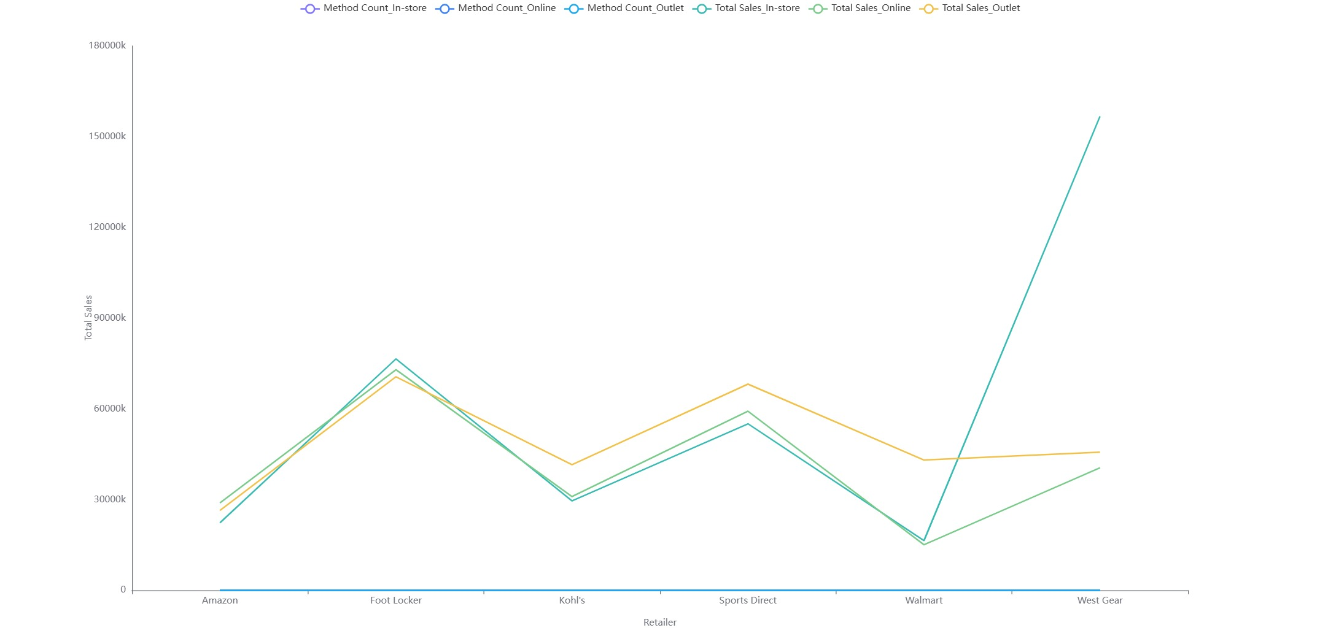

Slide 27
kaushikmaji44@gmail.com / Kaushik Maji

